Slide 1

Lecture-4 Introduction to Deadlocks
Core Topics:
Deadlock Definition
Necessary Conditions for Deadlock (Coffman’s Conditions)
Resource Allocation Graph (RAG)
Deadlock Handling Strategies
Banker’s Algorithm (Avoidance)
Recovery from Deadlock

Slide 2

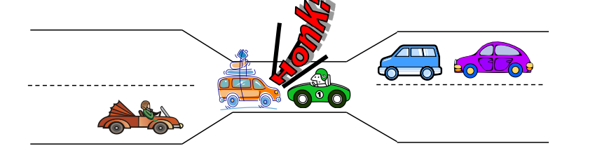
Deadlock
Bridge Crossing Example
Traffic only in one direction.
Each section of a bridge can be viewed as a resource.
If a deadlock occurs, it can be resolved if one car backs up (preempt resources and rollback).
Several cars may have to be backed up if a deadlock occurs.
Starvation is possible.

Slide 3
DEADLOCK CHARACTERISATION
NECESSARY CONDITIONS
ALL of these four must happen simultaneously for a deadlock to occur:
Mutual exclusion
One or more than one resource must be held by a process in a non-sharable (exclusive) mode.
Hold and Wait
A process holds a resource while waiting for another resource.
No Preemption
There is only voluntary release of a resource - nobody else can make a process give up a resource.
Circular Wait
Process A waits for Process B waits for Process C .... waits for Process A.

Slide 4
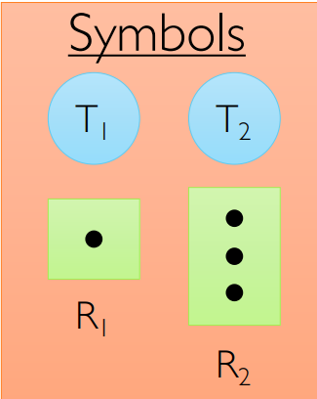
RESOURCE ALLOCATION GRAPH
Threads T1, T2, . . ., Tn
Resource types R1, R2, . . ., Rm
Each resource type Ri has Wij instances
Each thread utilizes resources as follows
Request() / Use() / Release()
Request edge is directed edge Ti -> Rj
Assignment edge is directed edge Rq -> Tp

Slide 5
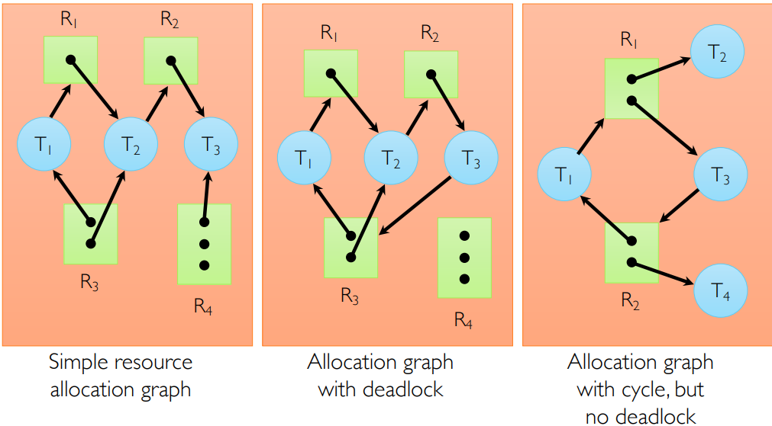
Resource Allocation Graph Examples

Slide 6

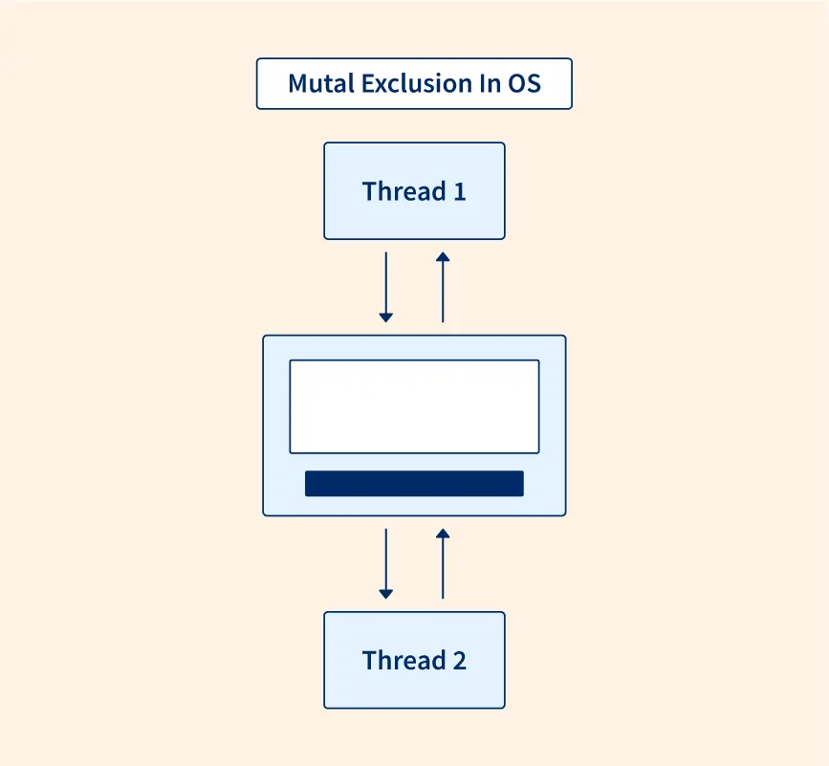
Deadlock Prevention
Do not allow one of the four conditions to occur.
Mutual exclusion:
Automatically holds for printers and other non-shareables.
Shared entities (read only files) don't need mutual exclusion (and aren’t susceptible to deadlock.)
Prevention not possible, since some devices are intrinsically non-sharable.

Slide 7
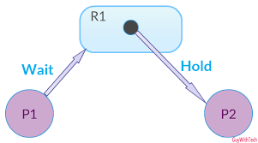
Deadlock Prevention
Do not allow one of the four conditions to occur.
Hold and wait:
Collect all resources before execution.
A particular resource can only be requested when no others are being held. A sequence of resources is always collected beginning with the same one.
Utilization is low, starvation possible.

Slide 8
Deadlock Prevention
Do not allow one of the four conditions to occur.
No preemption:
Release any resource already being held if the process can't get an additional resource.
Allow preemption - if a needed resource is held by another process, which is also waiting on some resource, steal it. Otherwise wait.

Slide 9
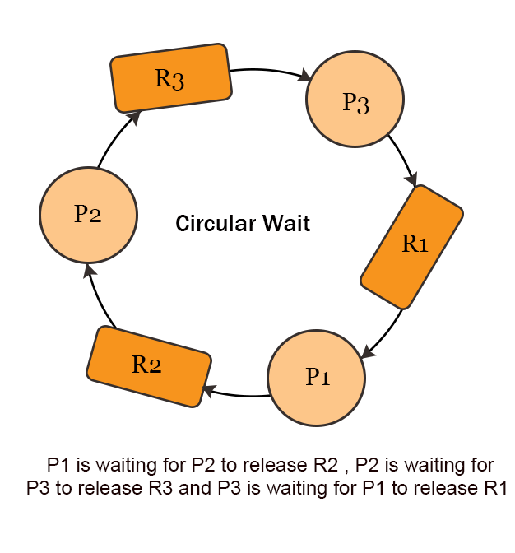
Deadlock Prevention
Do not allow one of the four conditions to occur.
Circular wait:
Number resources and only request in ascending order.
Each of these prevention techniques may cause a decrease in utilization and/or resources. For this reason, prevention isn't necessarily the best technique.
Prevention is generally the easiest to implement.

Slide 10
Deadlock Avoidance
If we have prior knowledge of how resources will be requested, it's possible to determine if we are entering an "unsafe" state.
Possible states are:
Deadlock: No forward progress can be made.
Unsafe state: A state that may allow deadlock.
Safe state: A state is safe if a sequence of processes exist such that there are enough resources for the first to finish, and as each finishes and releases its resources there are enough for the next to finish.
The rule is simple: If a request allocation would cause an unsafe state, do not honor that request.
NOTE: All deadlocks are unsafe, but all unsafes are NOT deadlocks.

Slide 11
Deadlock Avoidance
NOTE: All deadlocks are unsafe, but all unsafes are NOT deadlocks.
SAFE
UNSAFE
DEADLOCK
Only with luck will processes avoid deadlock.
O.S. can avoid
deadlock.

Slide 12
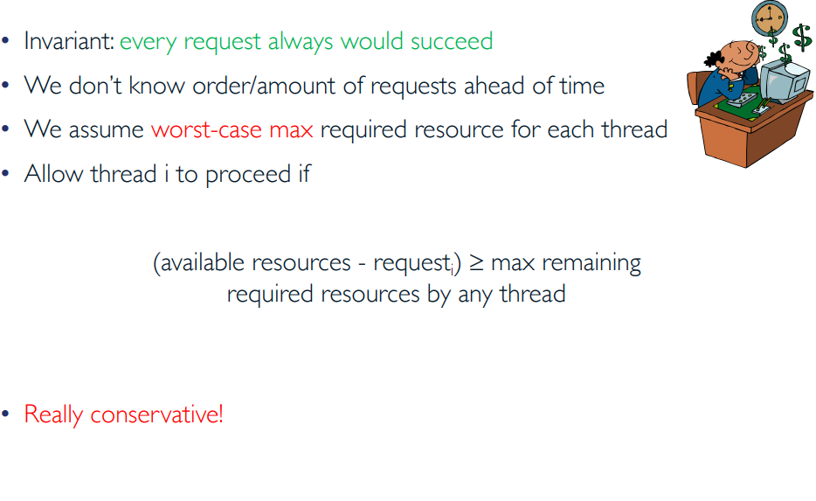
Banker’s Algorithm

Slide 13
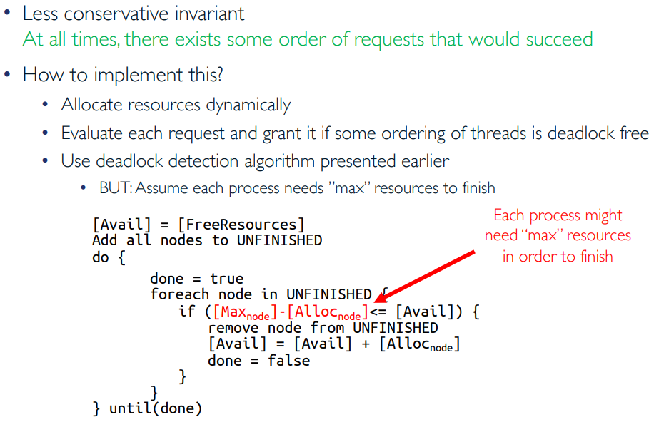
Banker’s Algorithm (cont.)

Slide 14
Slow Learner Activities

Slide 15
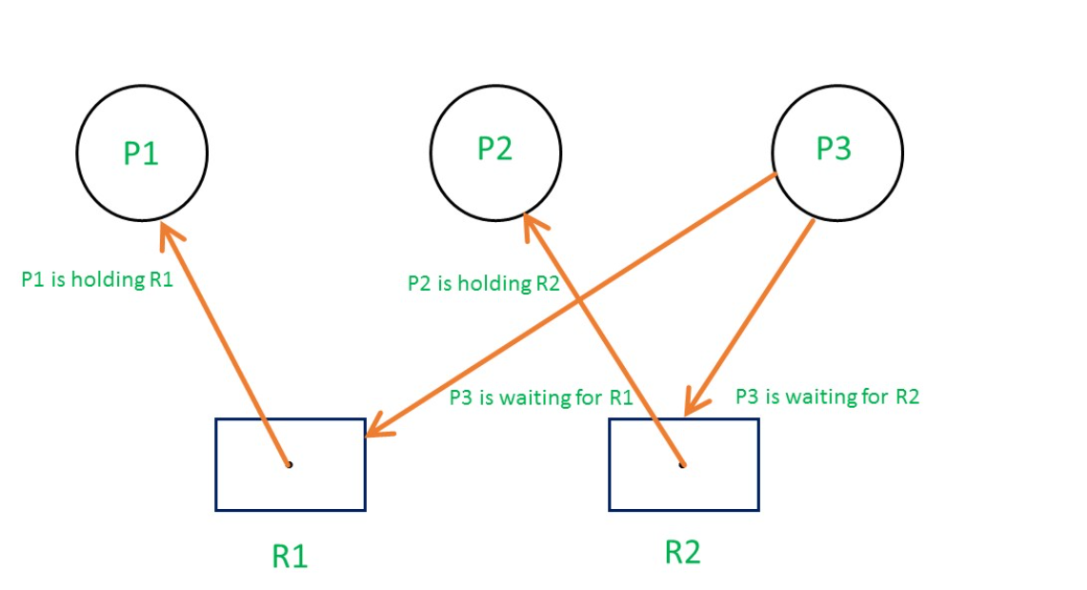
Slow Learners Activity 1

Slide 16
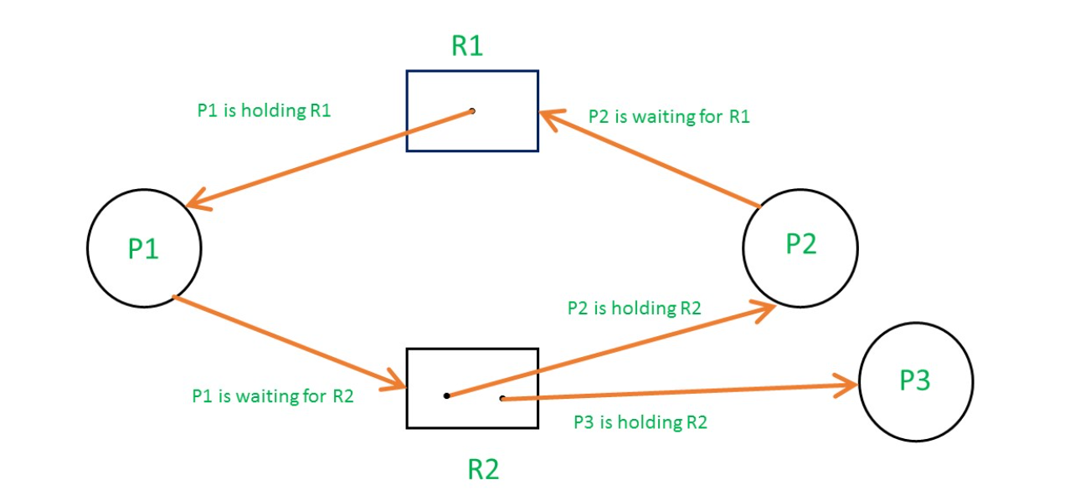
Slow Learners Activity 2

Slide 17
Slow Learners Activity 3
Scenario 1: Traffic Gridlock at an Intersection
Story:
Imagine a four-way intersection without traffic lights. Cars from all four directions enter the intersection at the same time, and each one blocks the next car's way. No car can move forward or reverse, and the entire intersection is stuck.
Identifying Deadlock Conditions:

Slide 18
Slow Learners Activity 4
Scenario 2: Office Printers
Story:
Two employees, Alice and Bob, are printing and scanning documents. Alice is using the printer and needs the scanner, while Bob is using the scanner and needs the printer. Both are waiting for the other to release the resource.
Identifying Deadlock Conditions:

Slide 19
Moderate Learner Activities

Slide 20
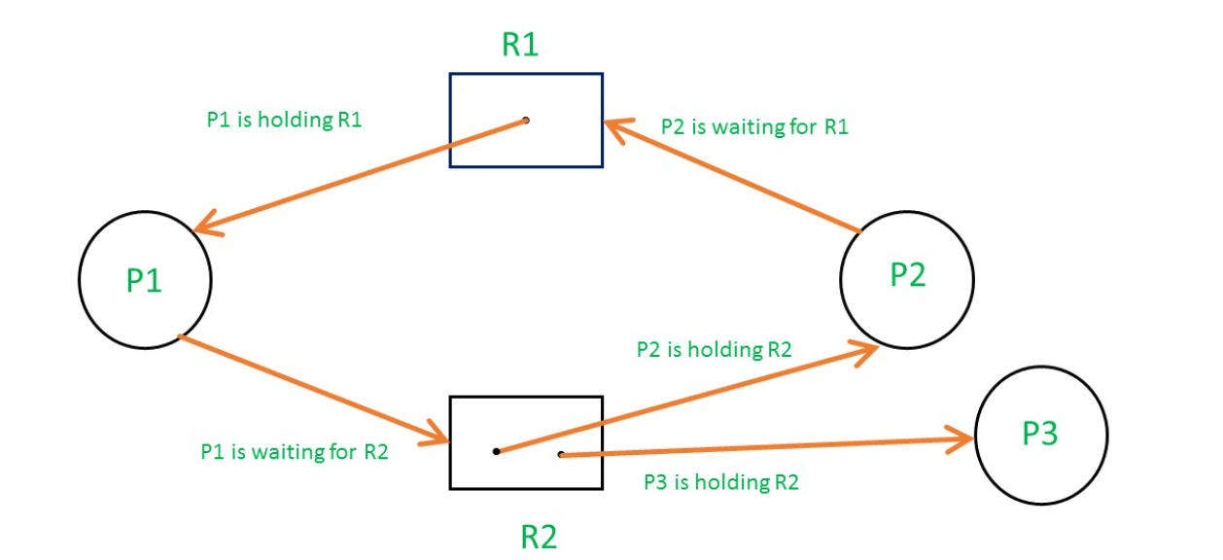
Moderate Learners Activity 1
Scenario 2: Office Printers
Story:
Two employees, Alice and Bob, are printing and scanning documents. Alice is using the printer and needs the scanner, while Bob is using the scanner and needs the printer. Both are waiting for the other to release the resource.
Identifying Deadlock Conditions:

Slide 21
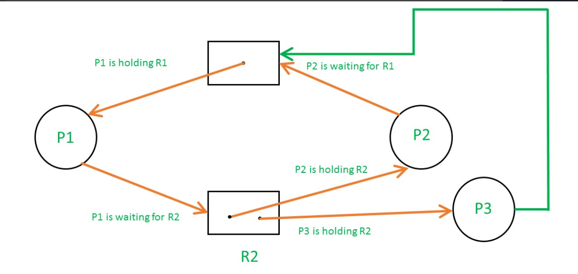
Moderate Learners Activity 2

Slide 22
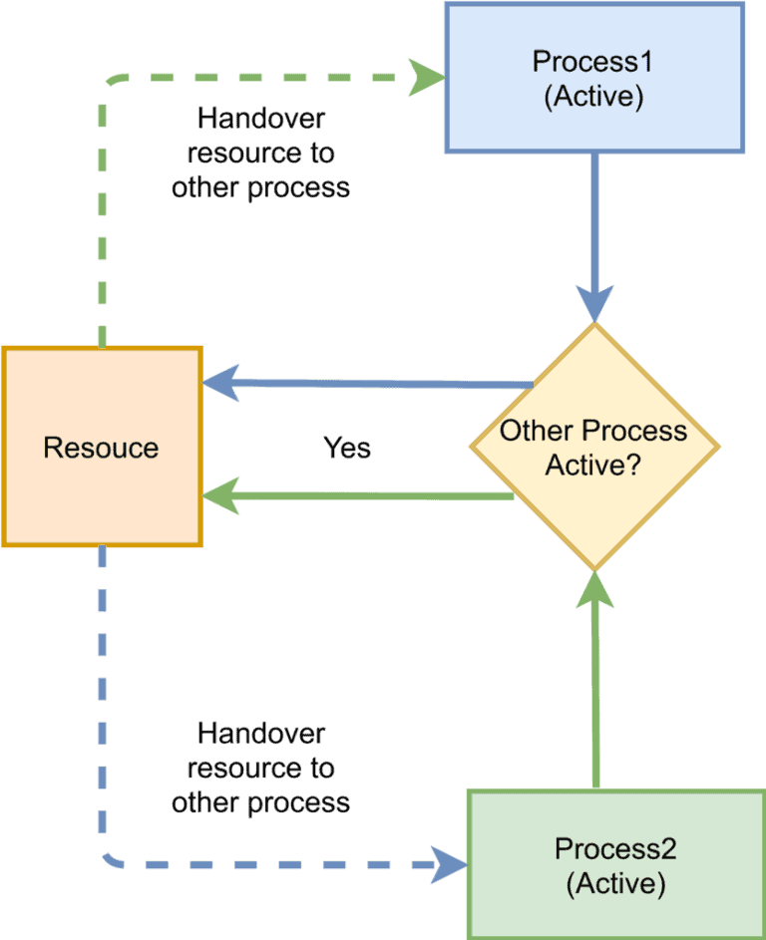
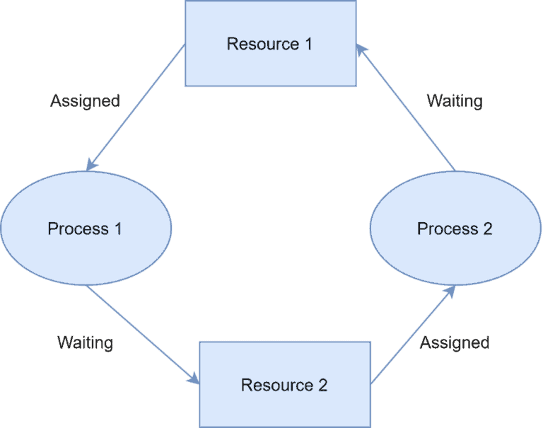
Moderate Learners Activity 3
Identify Deadlock, Livelock, Starvation

Slide 23
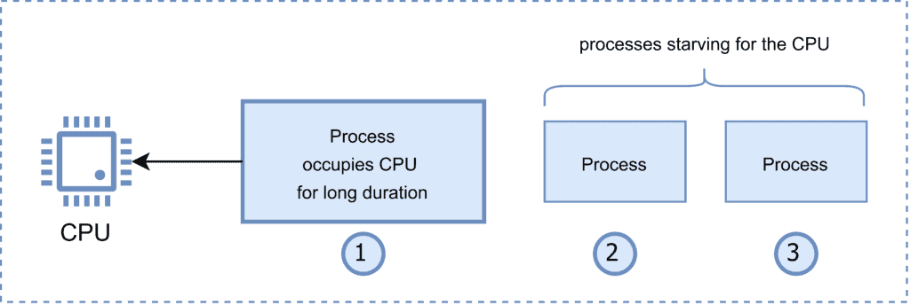
Moderate Learners Activity 3
Identify Deadlock, Livelock, Starvation

Slide 24
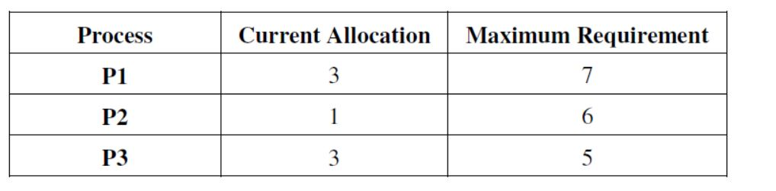
Moderate Learners Activity 4
A system shares 9 tape drives. The current allocation and maximum requirement of tape drives for three processes are shown below:
Describe best current state of the system ?

Slide 25
Fast Learner Activities

Slide 26
Fast Learners Activity 1
Oracle Database Deadlock (2019)
Scenario: A financial institution experienced recurring deadlocks in their Oracle 12c database during end-of-day batch processing.
Root Cause:
Multiple batch jobs updating customer accounts in different orders
Job A: Locked account X, then attempted to lock account Y
Job B: Locked account Y, then attempted to lock account X
Circular wait condition created
What resolution was proposed?

Slide 27
Fast Learners Activity 2
2. Linux Kernel Deadlock (2016, Kernel 4.4)
Scenario: Users reported system hangs during certain filesystem operations.
Technical Details:
Process A held inode lock, waiting for journal transaction
Process B (journal thread) held transaction lock, waiting for inode lock
Both in uninterruptible sleep (D state)
What resolution was proposed?

Slide 28
Fast Learners Activity 3
3. SQL Server Deadlock in E-Commerce (2020)
Scenario: High-traffic e-commerce site experienced checkout failures during peak periods.
Analysis:
Deadlocks between inventory updates and order creation
60% involved three or more processes in complex wait chains
Schema design encouraged lock contention on product records
What resolution was proposed?

Slide 29
Fast Learners Activity 4
What are the common Deadlock Patterns you can think of?
What prevention and Mitigation Strategies you can think of?

